Slide 1
Area of composite shapes
Perimeter, area and volume

Slide 2
how to use Oak lessons

Slide 3
I can solve area problems of composite shapes involving whole and/or part circles.

Slide 4
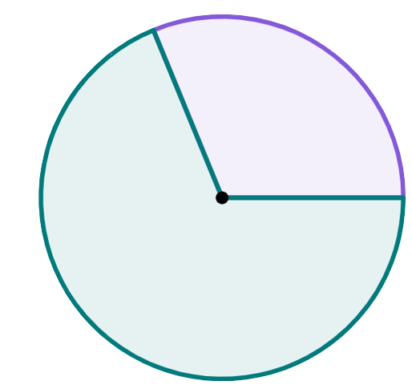
A sector is the region formed between two radii and their connecting arc.
sector
sector
radius

Slide 5

Area of composite shapes
Finding the area of sectors of a circle
Finding the area of composite shapes with sectors

Slide 6
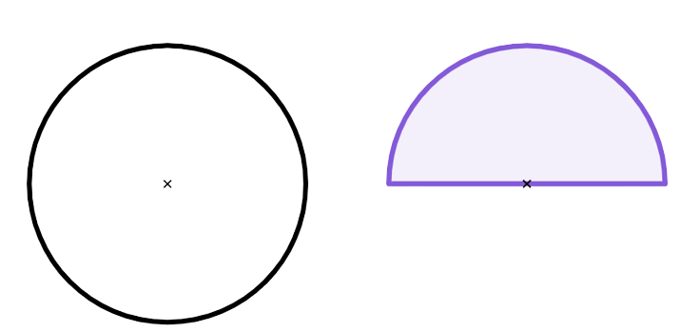
Finding the area of sectors of a circle
How would you find the area of this circle?
r = 18 cm
r = 18 cm
This semicircle is exactly half of the circle on the left.
It was made by cutting along a diameter of that circle.
It has the same radius as this circle.
What is the area of this semicircle?
area = π × r²
area = π × 18²
area = 324π = 1017.9 cm²

Slide 7
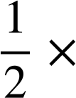
Finding the area of sectors of a circle
How would you find the area of this circle?
half a circle
r = 18 cm
r = 18 cm
area = π × r²
area =
π × r²
half the area
area = π × 18²
area = π × 18²
area = 324π = 1017.9 cm²
area = 162π = 508.9 cm²

Slide 8


Finding the area of sectors of a circle
I need to be careful with my order of operations!
I need to square the radius (18) first before multiplying the result by a half!
r = 18 cm
area = π × r²
area = π × 18²
area = π × 324
area = 162 π = 508.9 cm² (1d.p.)

Slide 9
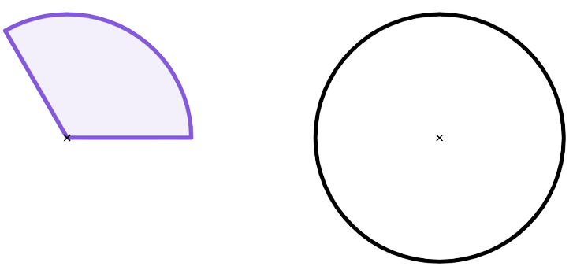

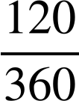
Finding the area of sectors of a circle
Each of these three sectors are congruent to each other, and fit perfectly inside this circle with a radius of 6 cm.
What angles and fractions describe each sector in relation to the whole circle?
each sector is of a full circle
each sector has an angle of 360 ÷ 3 = 120°
each sector represents of a full circle

Slide 10
Finding the area of sectors of a circle
The area of the full circle is:
One third of a circle.
r = 6 cm
r = 6 cm
area = π × r²
area = × π × r²
the area
area = π × 6²
area = × π × 6²
area = 36π = 113.1 cm²
area = 12π = 37.7 cm²

Slide 11



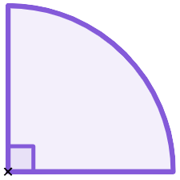
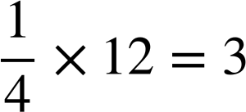
Finding the area of sectors of a circle
Whose method to find the area of this quarter circle is correct?
Andeep
Sofia
radius = 12
radius = 12
area = × π × 12²
area = π × 3²
area = × π × 144
r = 12 cm
area = 9π cm²
area = 36π cm²
To find the area of a sector you must multiply the area by the fraction of a full circle, not the radius.

Slide 12

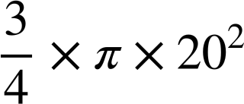
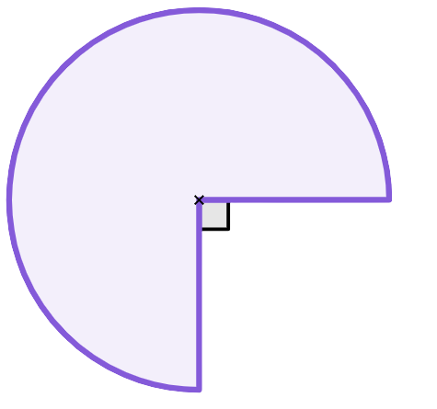

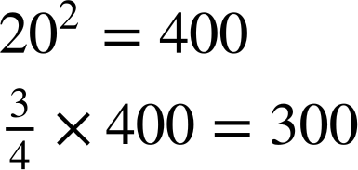

Finding the area of sectors of a circle
Which of these calculations correctly shows the area of this sector?
Square the radius first, then find of the result.
a
b
r = 20 cm
c

Slide 13
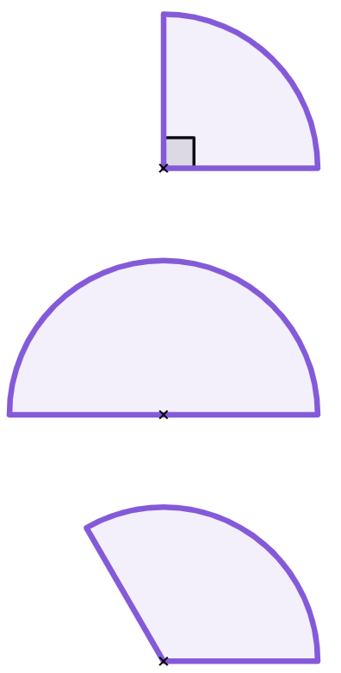
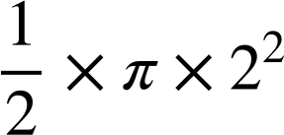
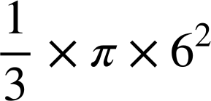


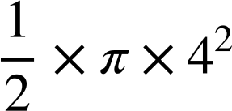
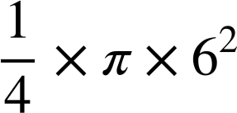


Finding the area of sectors of a circle
1) Match the circle sectors with the possible correct calculations and answers. Some calculations do not match with a sector.
1
2
3
120°
r = 6 cm
r = 4 cm
r = 6 cm
a
b
e
f
c
d
g
h

Slide 14
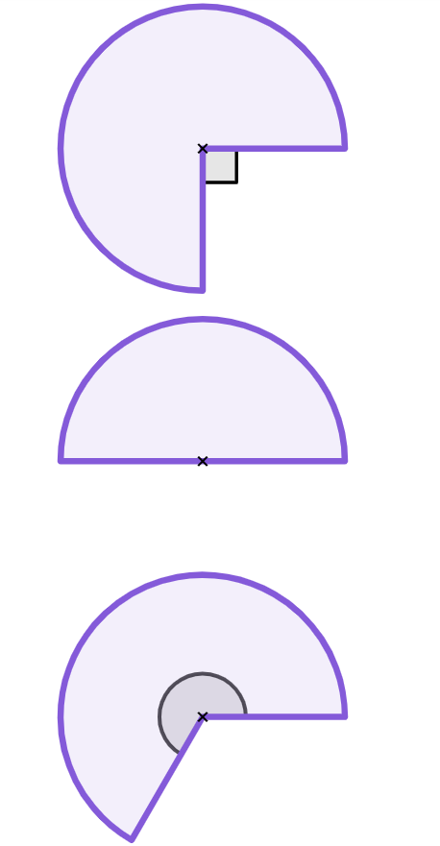
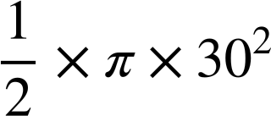
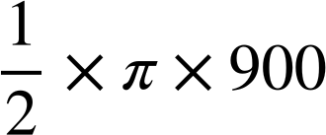
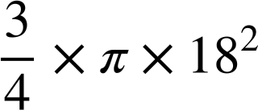

Finding the area of sectors of a circle
2) Complete the table. Give your answer both as a decimal (rounded to 1 d.p.) and in terms of π.
sector | step 1 | step 2 | answer (cm²)
 |  |  | 763.4
 |  |  | 2166π
a)
30 cm
b)
18 cm
c)
240°
57 cm

Slide 15
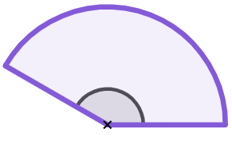
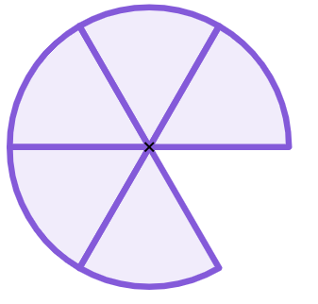
Finding the area of sectors of a circle
2) Complete the table. Give your answer both as a decimal (rounded to 1 d.p.) and in terms of π.
sector | step 1 | step 2 | answer (cm²)
d)
d = 160 cm
e)
150°
84 cm
f)
7.2 cm

Slide 16
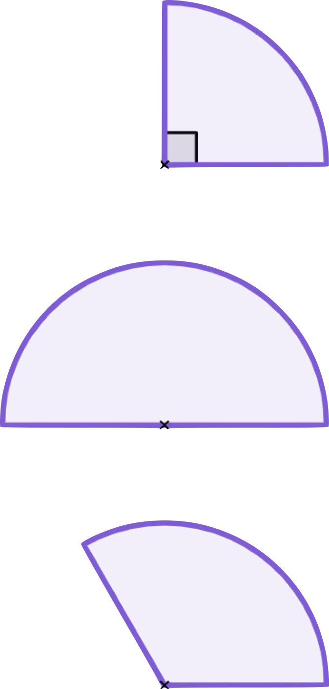
Finding the area of sectors of a circle
1) Match the circle sectors with the possible correct calculations and answers. Some calculations do not match with a sector.
1
2
3
120°
r = 6 cm
r = 4 cm
r = 6 cm
d
c
b
g
f
h

Slide 17

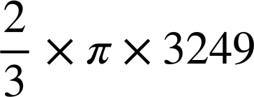
Finding the area of sectors of a circle
2) Complete the table. Give your answer both as a decimal (rounded to 1 d.p.) and in terms of π.
sector | step 1 | step 2 | answer (cm²)
 |  |  | 450π 1413.7
 |  |  | 243π 763.4
 |  |  | 2166π 6804.7
a)
30 cm
b)
18 cm
2
c)
240°
3
or
240
57 cm
360

Slide 18
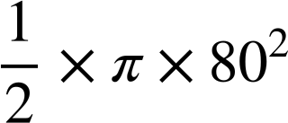
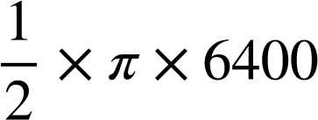
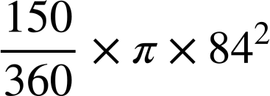
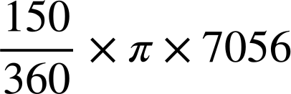
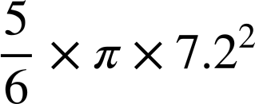
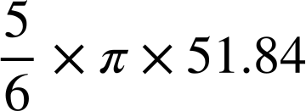
Finding the area of sectors of a circle
sector | step 1 | step 2 | answer (cm²)
 |  |  | 3200π 10 053.1
 |  |  | 2940π 9236.3
 |  |  | 43.2π 135.7
d)
d = 160 cm
e)
150°
84 cm
f)
7.2 cm

Slide 19
Area of composite shapes
Finding the area of sectors of a circle
Finding the area of composite shapes with sectors

Slide 20
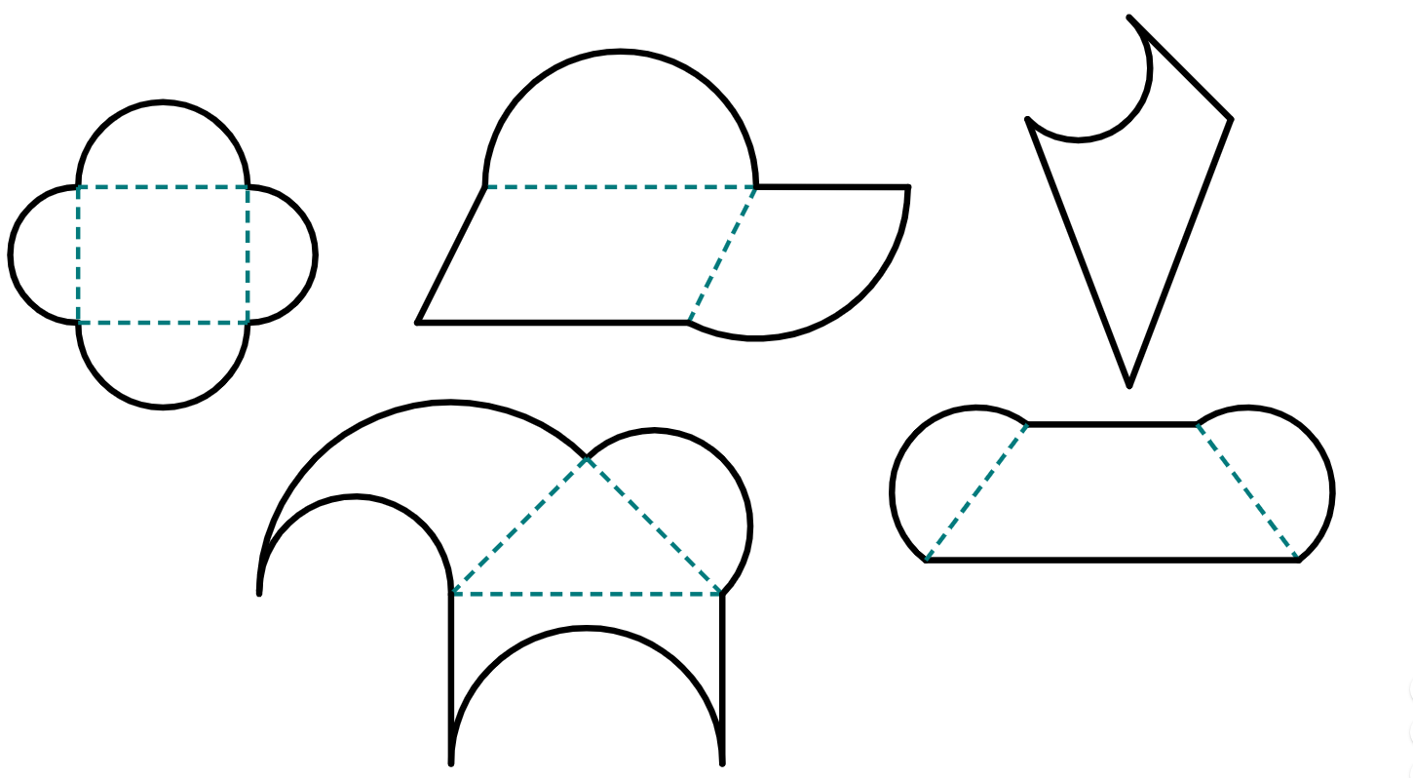
Finding the area of composite shapes with sectors
Composite shapes can be made from different combinations of all sorts of shapes.
Each component shape we will look at during this lesson will either be a rectangle (with all angles at 90°), or a sector of circle.

Slide 21
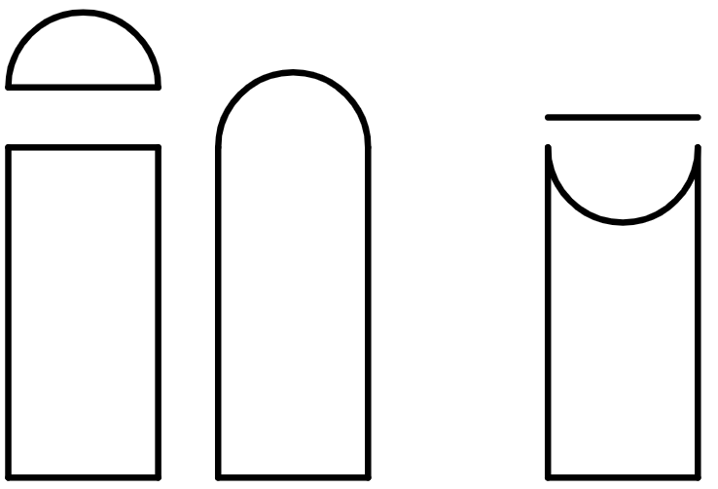
Finding the area of composite shapes with sectors
To find the area of a composite shape, you can break it up into its component parts.

Slide 22

Finding the area of composite shapes with sectors
10 cm
Calculate the area of this composite shape by breaking it into component parts.
The diameter of this semicircle is equal to the base length of the rectangle.
8 cm
10 cm

Slide 23
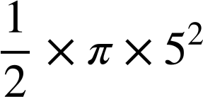
Finding the area of composite shapes with sectors
Calculate the area of this composite shape by breaking it into component parts.
10 cm
semicircle part
5 cm
diameter = 10 cm
radius = 5 cm
area =
8 cm
= 12.5π
rectangle part
10 cm
area = 10 × 8 = 80

Slide 24
Finding the area of composite shapes with sectors
Calculate the area of this composite shape by breaking it into component parts.
Or as a decimal.
10 cm
semicircle part
We can leave our answer in terms of π.
This can be expressed by writing down the addition of two terms: the π term and the non-π term, and leaving each term separate.
5 cm
area = 12.5π
rectangle part
area = 80
8 cm
area of composite shape = 12.5π + 80
area of composite shape = 119.3 cm²
10 cm

Slide 25
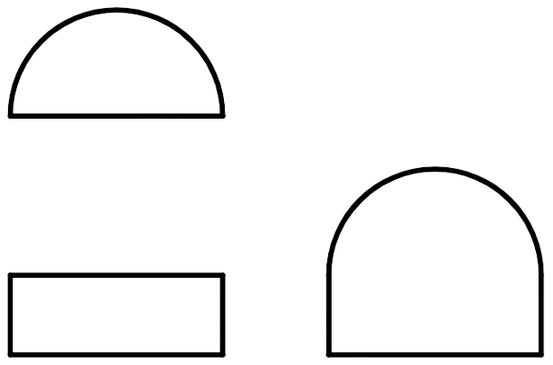
Finding the area of composite shapes with sectors
Calculate the area of this composite shape by breaking it into component parts.
Calculate the area of this composite shape by breaking it into component parts.
3 cm
5 cm
12 cm
16 cm

Slide 26
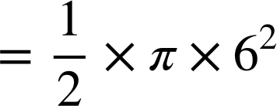
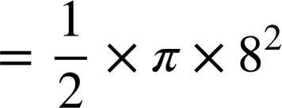
Finding the area of composite shapes with sectors
semicircle part
semicircle part
diameter = 12 cm
radius = 6 cm
diameter = 16 cm
radius = 8 cm
12 cm
16 cm
area
6 cm
8 cm
= 18π
= 32π
rectangle part
rectangle part
3 cm
5 cm
area = 3 × 12
area = 16 × 5
12 cm
= 36
16 cm
= 80
total area = 18π + 36
= 92.5 cm²
total area = 32π + 80
= 180.5 cm²

Slide 27
Finding the area of composite shapes with sectors
Composite shapes may be made by removing combinations of quadrilaterals and sectors of circles from each other.
To find the area of a composite shape, you can complete the shape by setting up a subtraction between its component parts.
Area of rectangle
Subtract the area of a sector

Slide 28
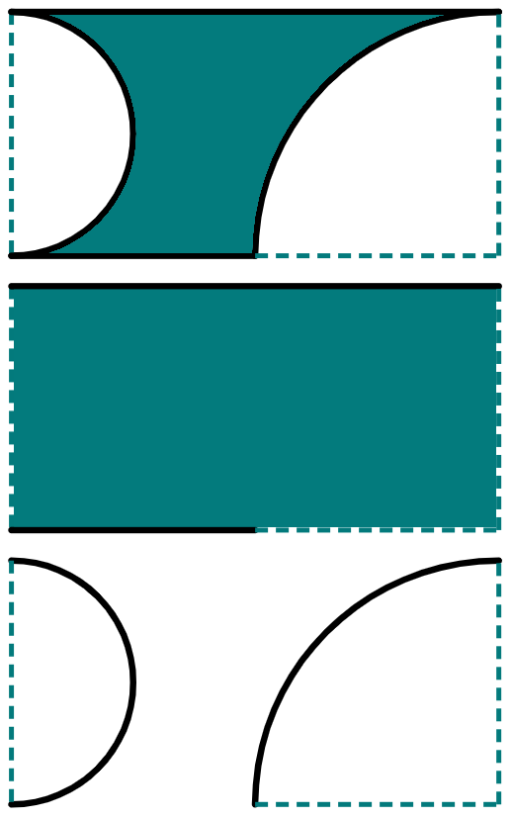
Finding the area of composite shapes with sectors
Demonstration
Calculate the area of the shaded region by completing the shape.
You do
Calculate the area of the shaded region by completing the shape.
25 cm
11 cm
12 cm
4 cm

Slide 29
Finding the area of composite shapes with sectors
25 cm
11 cm
12 cm
4 cm
12 cm
4 cm
First, separate the composite shape into its component parts.
Try it yourself.

Slide 30
Finding the area of composite shapes with sectors
25 cm
11 cm
12 cm
4 cm
6 cm
2 cm
12 cm
12 cm
4 cm
4 cm
12 cm
4 cm
Using the known values, label all missing sides and convert any diameters into radii.
Try it yourself.

Slide 31
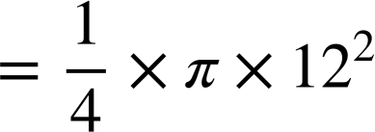
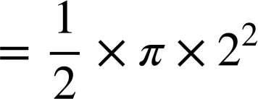
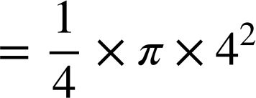
Finding the area of composite shapes with sectors
25 cm
11 cm
rectangle part
rectangle part
12 cm
area = 25 × 12
4 cm
area = 11 × 4
= 300
= 44
6 cm
2 cm
12 cm
4 cm
12 cm
4 cm
semicircle part
quarter-circle part
semicircle part
quarter-circle part
area
area
area
area
Try it yourself.
= 18π
= 36π
= 2π
= 4π

Slide 32
Finding the area of composite shapes with sectors
25 cm
11 cm
12 cm
4 cm
rectangle part
area of shaded region
rectangle part
area of shaded region
area = 300
area = 44
300 – 18π – 36π
= 44 – 6π
semicircle part
semicircle part
area = 18π
= 300 – 54π
area = 2π
quarter-circle part
quarter-circle part
area = 36π
area = 4π
Try it yourself.

Slide 33
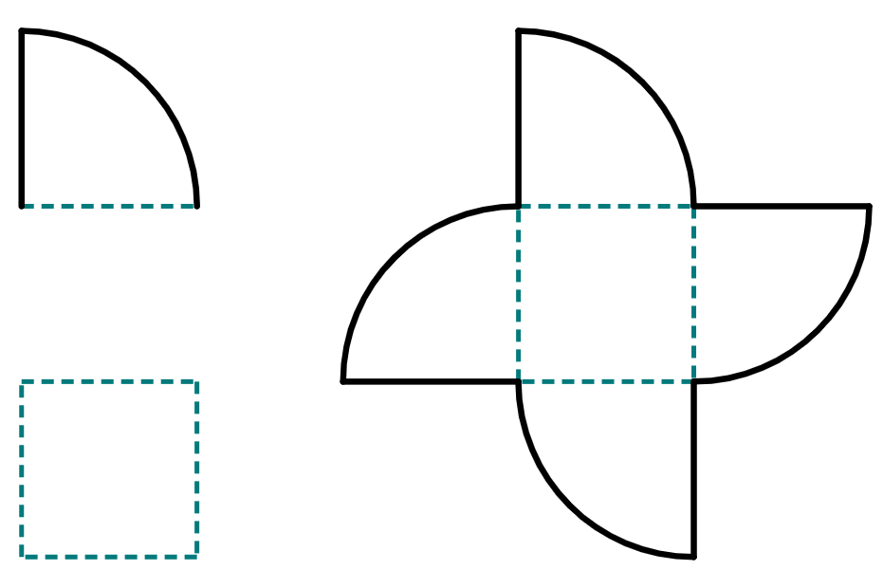
Finding the area of composite shapes with sectors
Component parts of a composite shape may be rearranged to make a more simple shape, or multiple simple shapes.
To find the area of a composite shape, you can rearrange component parts and then add together the rearranged shapes.
Four quarter-circles are rearranged into one full circle.
Plus the extra square in the centre of the shape.

Slide 34
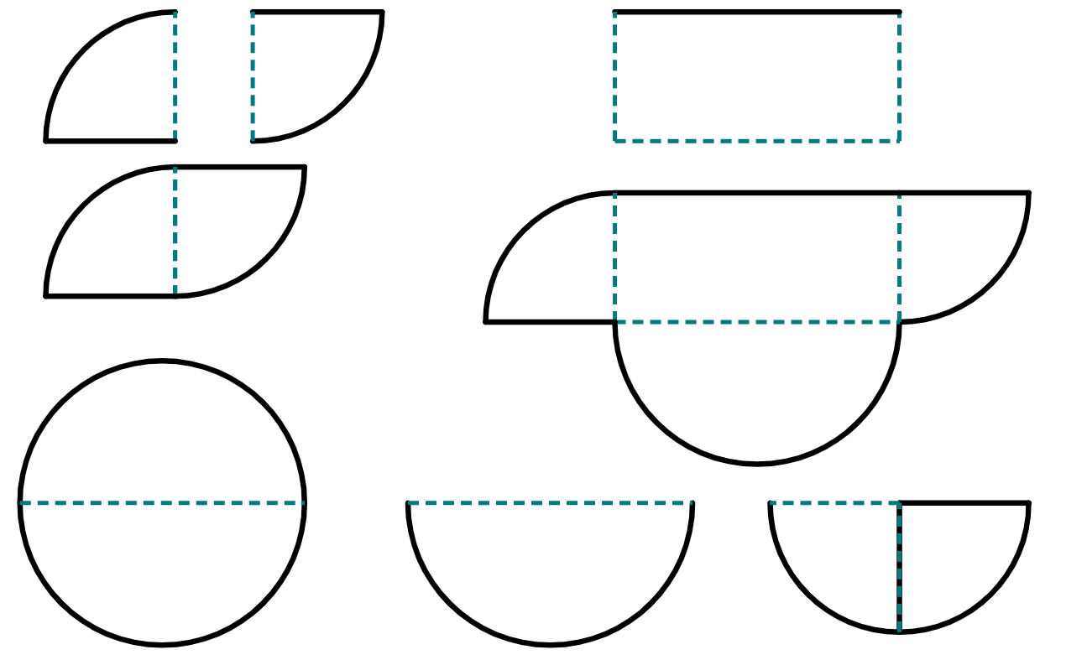
Finding the area of composite shapes with sectors
Which of these are component parts and rearrangements of this composite shape?
5.5 cm
5 cm
a
b
11 cm
f
5 cm
c
5 cm
11 cm
c
c
d
a
c is made from the two quarter-circles being rearranged into a semicircle with radius of 5 cm.
11 cm
11 cm
e
f
5 cm

Slide 35
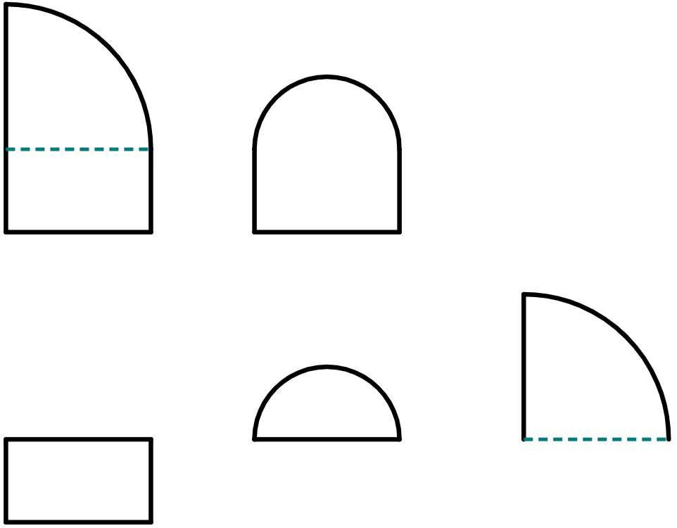
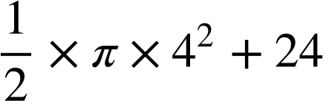
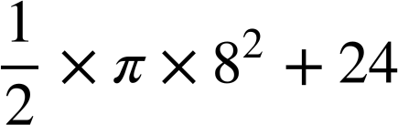
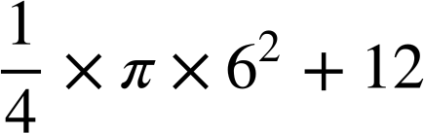
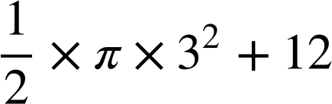
Finding the area of composite shapes with sectors
1) Match the composite shape to its component parts and calculations.
a
d
3 cm
2 cm
g
8 cm
6 cm
h
6 cm
2 cm
b
e
shape 1
8 cm
4 cm
i
j
8 cm
3 cm
c
f
shape 2
6 cm
3 cm

Slide 36
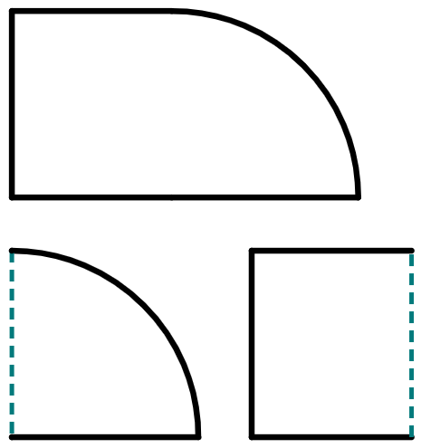
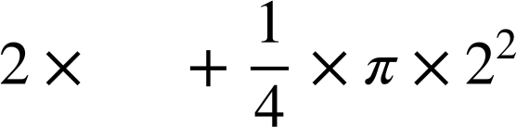
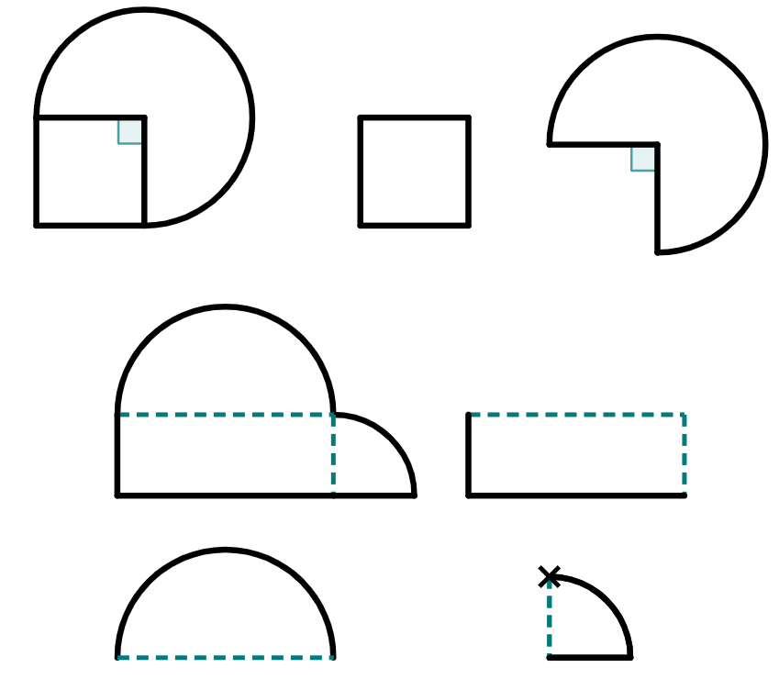
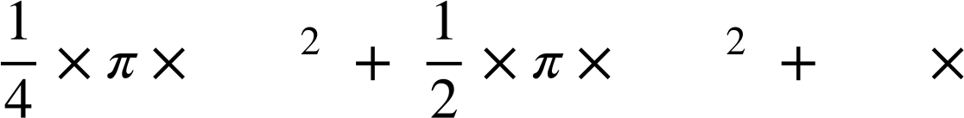
Finding the area of composite shapes with sectors
2) Complete the table. Give your answer as both a decimal and in terms of π.
shape | shape broken into parts | calculations (addition) | answer
 |  |  | 889.2 cm²
a)
7 cm
___ cm
2 cm
2 cm
___
b)
___
12 cm
___
32 cm
___
___

Slide 37

Finding the area of composite shapes with sectors
2) Complete the table. Give your answer as both a decimal and in terms of π.
shape | shape broken into parts | calculations (addition) | answer
c)
24 cm
d)
28 cm
44 cm

Slide 38

Finding the area of composite shapes with sectors
3) What do you notice about the areas of each shaded region?
Show your working to support your observations.
8 cm

Slide 39
Finding the area of composite shapes with sectors
1) Match the composite shape to its component parts and calculations.
d
2 cm
i
6 cm
c
6 cm
2 cm
6 cm
shape 1
3 cm
a
g
8 cm
3 cm
e
shape 2
4 cm
8 cm

Slide 40
Finding the area of composite shapes with sectors
1) Match the composite shape to its component parts and calculations.
j
b
8 cm
h
f
These did not match with either shape.
3 cm

Slide 41
Finding the area of composite shapes with sectors
2) Complete the table. Give your answer as both a decimal and in terms of π.
shape | shape broken into parts | calculations (addition) | answer
 |  |  | π + 14 17.1 cm²
 |  |  | 164π + 384 889.2 cm²
a)
7
7 cm
___ cm
2 cm
2 cm
7
b)
12
12 cm
32 cm
16
32 cm
12 cm
12
32

Slide 42


Finding the area of composite shapes with sectors
2) Complete the table. Give your answer as both a decimal and in terms of π.
shape | shape broken into parts | calculations (addition) | answer
 |  |  | 432π + 576 1933.2 cm²
 |  |  | 98π + 616 923.9 cm²
c)
24 cm
24 cm
24 cm
d)
28 cm
28 cm
44 cm
44 cm

Slide 43
Finding the area of composite shapes with sectors
3) What do you notice about the areas of each shaded region?
Show your working to support your observations.
¼
circle
¼
circle
½
circle
8 cm
¼
circle
¼
circle
½
circle
The area of each shaded region is equal, as the empty space in each shape can be rearranged to create one full circle. The area of the shaded region is 64 – 16π.

Slide 44
Area of composite shapes
Finding the area of a sector of a circle can be achieved using multiplicative reasoning; by multiplying the area of a full circle by the fraction of a full circle the sector represents, such as a quarter-circle representing ¼ of a full circle.
Finding the area of composite shapes can be achieved by either:
breaking a shape up into its component parts, such as rectangles, triangles, and circle sectors
completing a shape by considering what component part has been subtracted from the rest of a shape
rearranging a shape in order to make the resultant rearrangement a more simple shape to calculate the area of.

Slide 45

© Oak National Academy 2023.
Produced in partnership with Mathematics in Education and Industry.
Licensed on the Open Government Licence v3.0, except where otherwise stated. See Oak terms and conditions.

